Slide 1
IEEE UV2026 Paper Review Instructions on EasyChair
Reviewer Guide

Slide 2
Outline
Create an EasyChair Account [Slide 3]
Access Assigned Papers and Submit Reviews [Slide 11]
Method 1: Review with Your Own EasyChair Account (recommended) [Slide 12]
Method 2: Offline Review Form [Slide 21]
Check or Edit a Submitted Review [Slide 22]

Slide 3
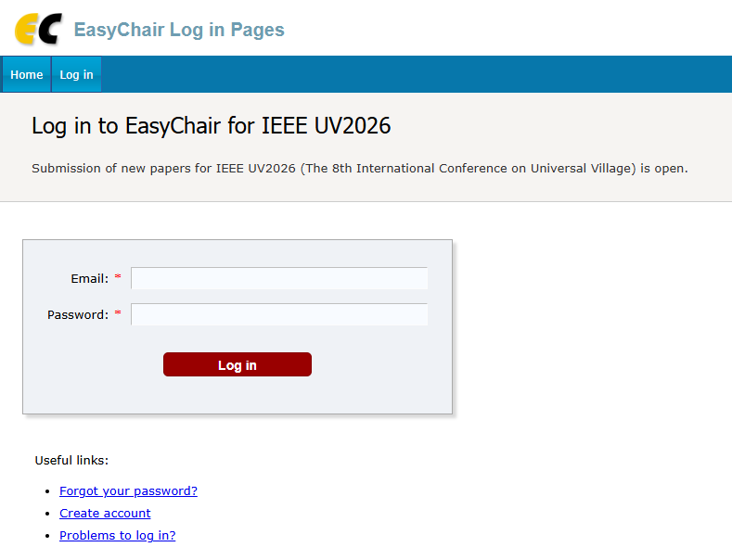
1. Create an EasyChair Account-1
a) Go to the EasyChair login page:
EasyChair: Log in （https://easychair.org/conferences/?conf=ieeeuv2026）
b) Click “Create account” to start the registration process.

Slide 4
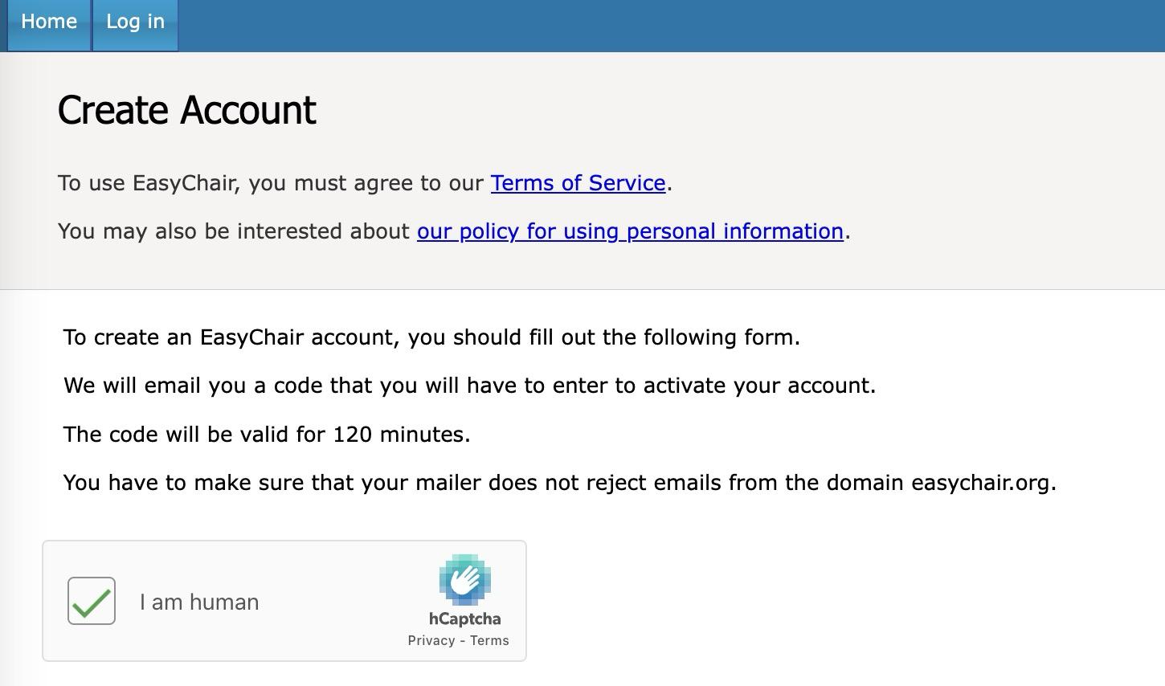
Create an EasyChair Account-2
c) Complete the human verification (reCAPTCHA) as required.

Slide 5
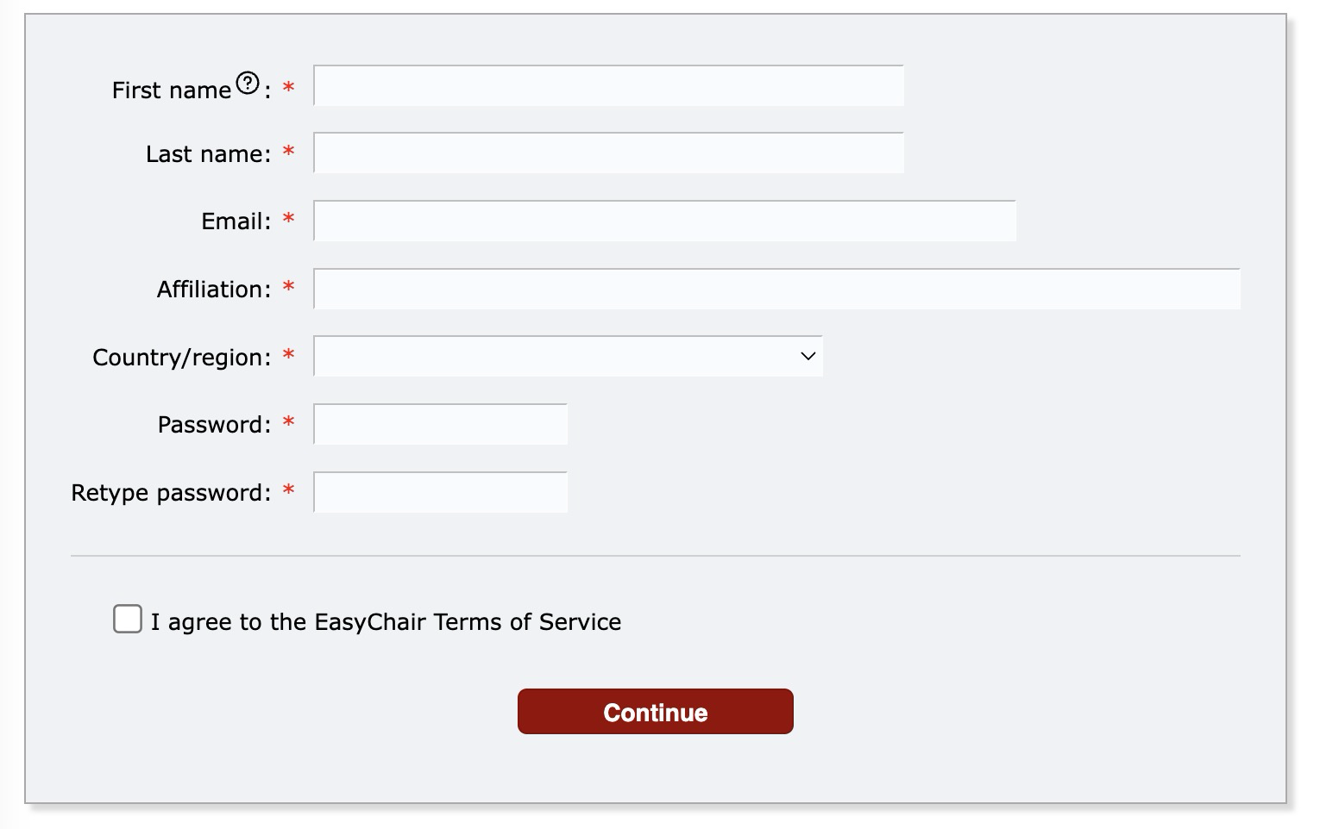
Create an EasyChair Account-3
d) Fill in your personal information in the registration form.

Slide 6
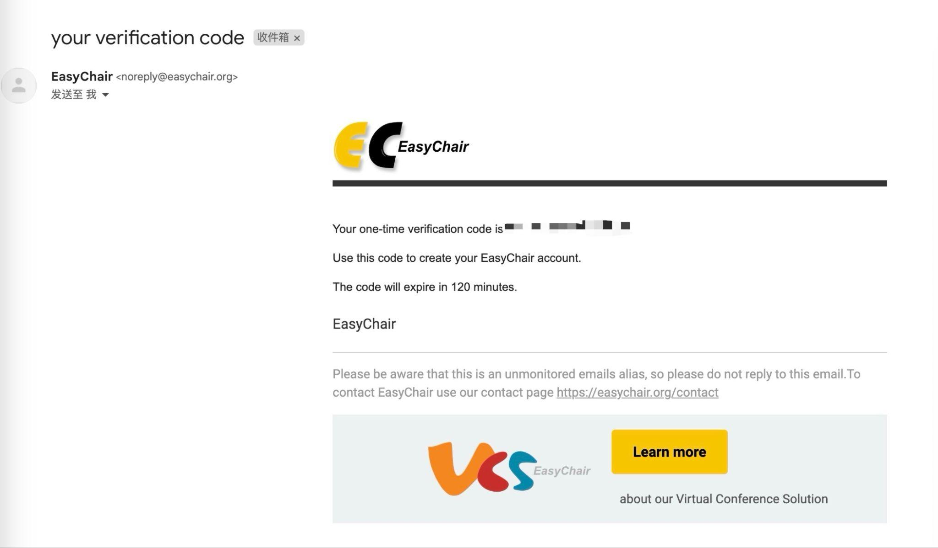
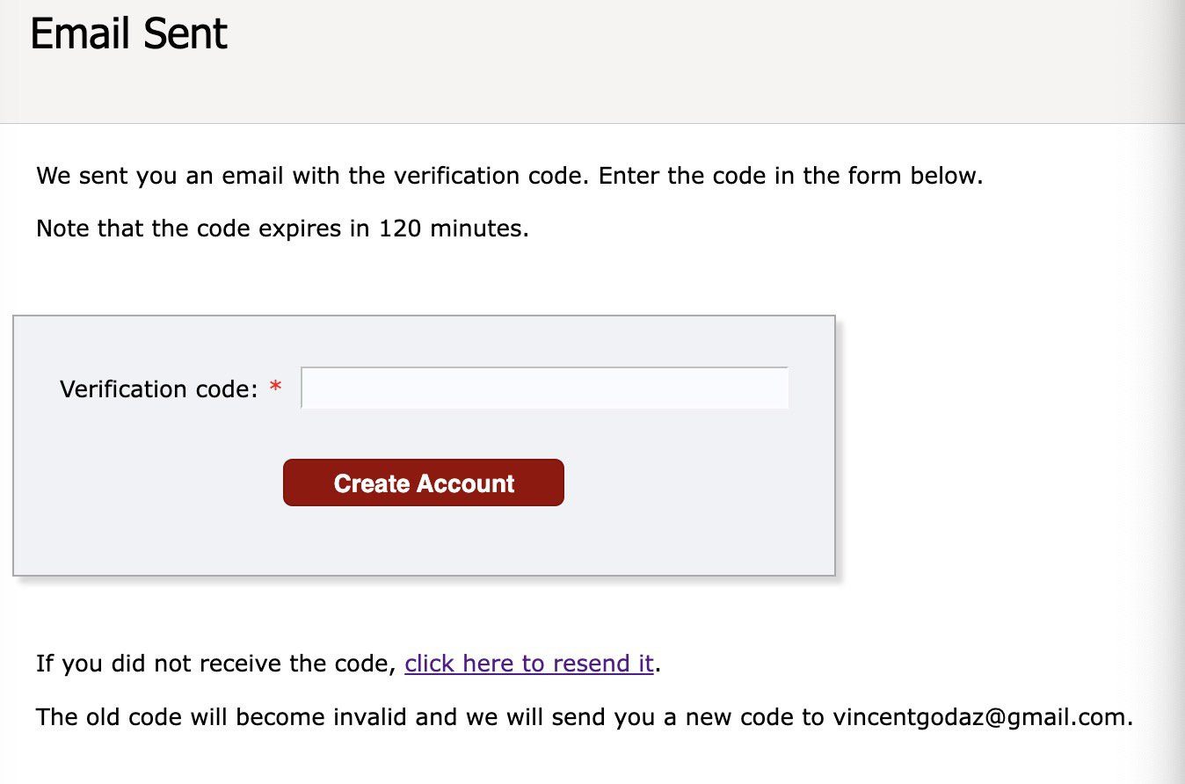
Create an EasyChair Account-4
e) After submitting the form, a confirmation message will be displayed, indicating that a verification email has been sent to your registered email address.
f) Check your email inbox for a verification message from EasyChair.
g) Enter the verification code provided in the email.
h) Click “Create account” to finalize your registration.

Slide 7
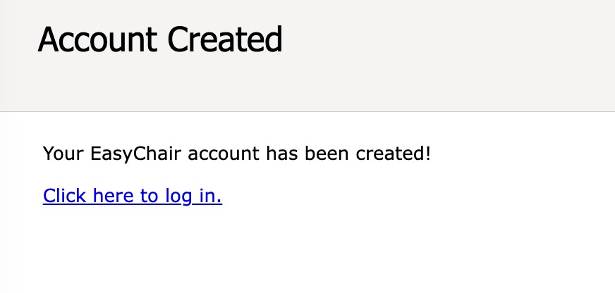
Create an EasyChair Account-5
i) Click the “Click here to log in” link to access the EasyChair login page.

Slide 8
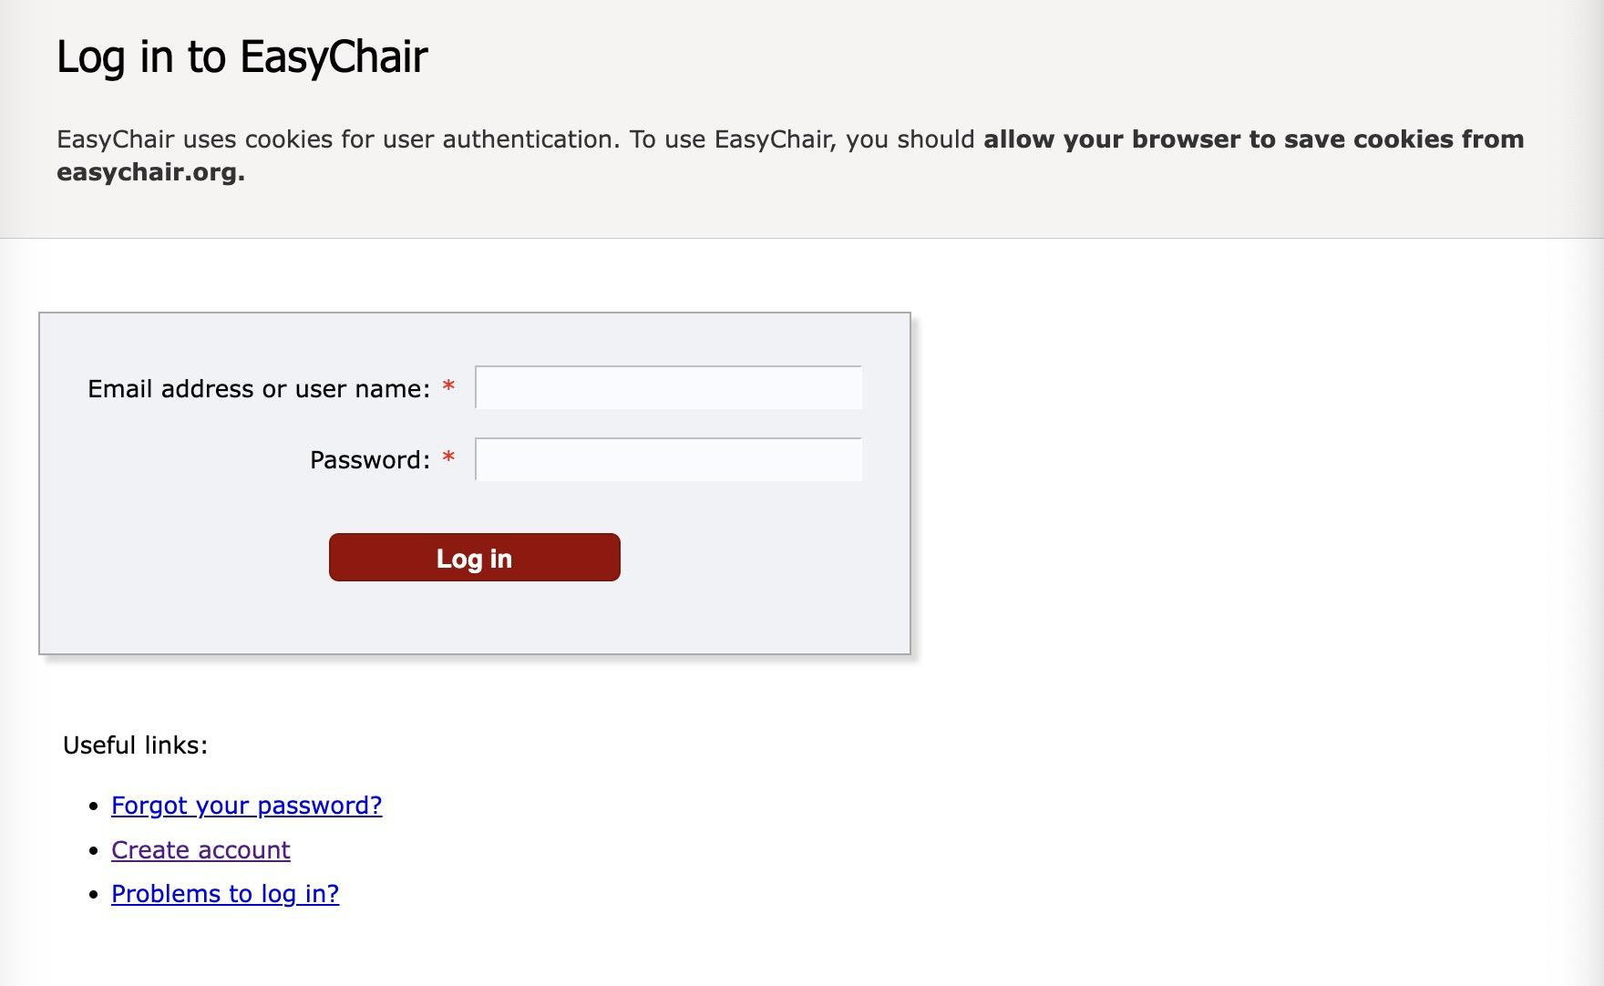
Create an EasyChair Account-6
j) You can now log in to EasyChair using your registered email address (or username) and password.
Log in （https://easychair.org/conferences/?conf=ieeeuv2026 ）

Slide 9

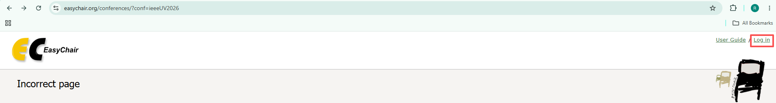
Create an EasyChair Account-7
Please make sure that you are logged in to EasyChair before accessing the IEEE UV2026 conference page (https://easychair.org/conferences/?conf=ieeeUV2026).
Otherwise, you may encounter the following error message.
Please click the “Log in” on the top right corner AND enter your account and password to log in.

Slide 10

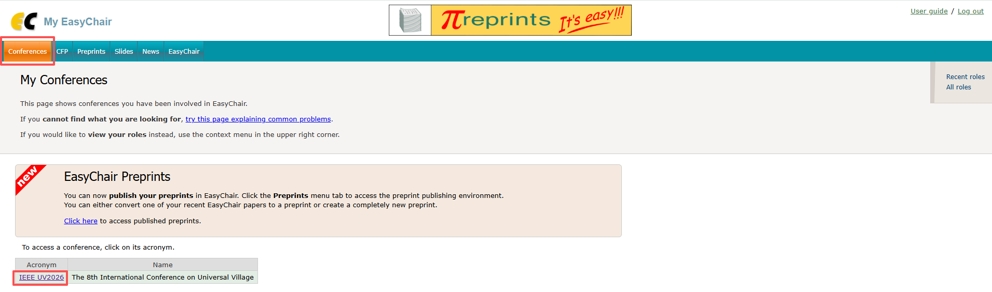

Create an EasyChair Account-8
b) After logging in, click on “Conferences” and then “IEEE UV2026” to access UV2026 Publication System

Slide 11
2. Review Papers as a Reviewer
Reviewers may access assigned papers and submit reviews through one of the following methods:
Method 1: Use your own EasyChair account (recommended)
Method 2: Use a chair-assisted review workflow, only if arranged by your session chair
Method 3: Use an offline review form if you have difficulty using EasyChair

Slide 12
2.1 Method 1: Use Your Own EasyChair Account-1
* Please create your personal EasyChair account first. Then contact your session chair so that the assigned paper(s) can be assigned to your EasyChair account. Once the assignment has been completed, please follow the steps below to review the paper(s).

Slide 13
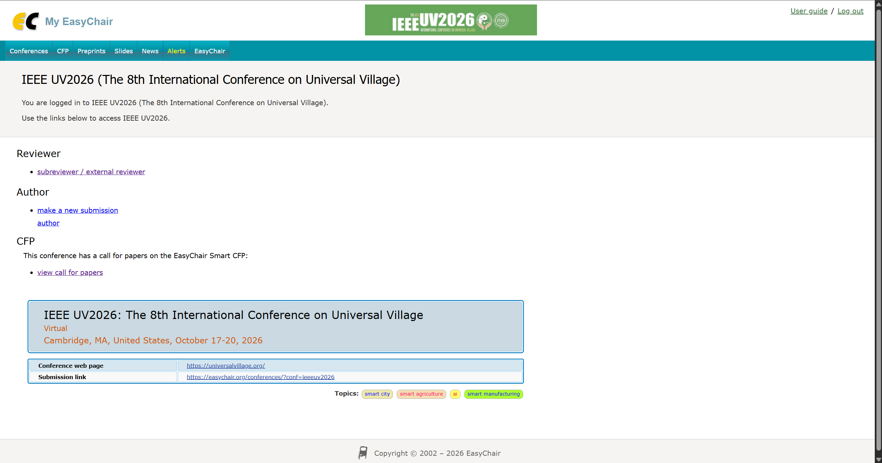
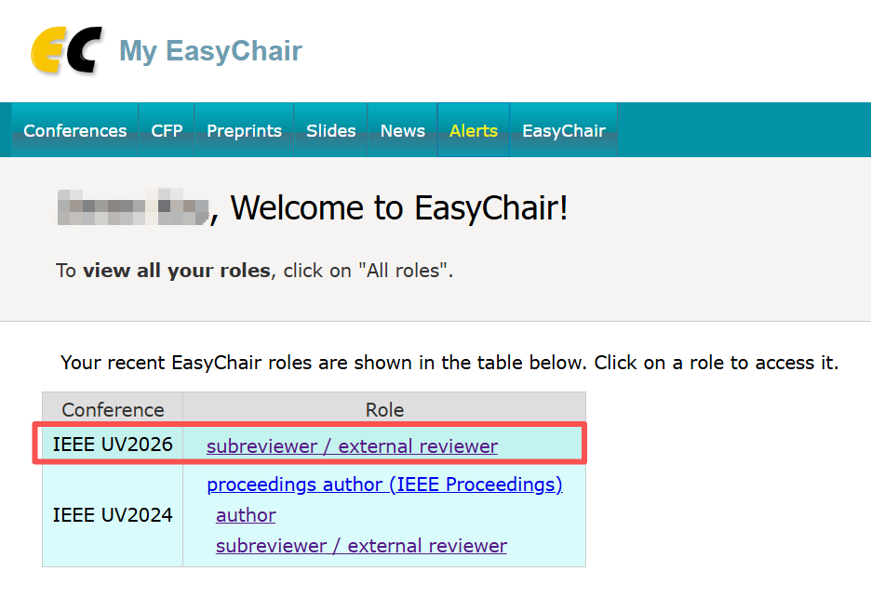
2.1 Method 1: Use Your Own EasyChair Account-2
a) After logging in, you will see the EasyChair reviewer interface shown below. Click “Subreviewer” to access your assigned review request(s).
If the “Subreviewer” role does not appear, please contact your session chair or the UV2026 Organizing Committee at uv.conf.committee@universal-village.org for assistance.

Slide 14

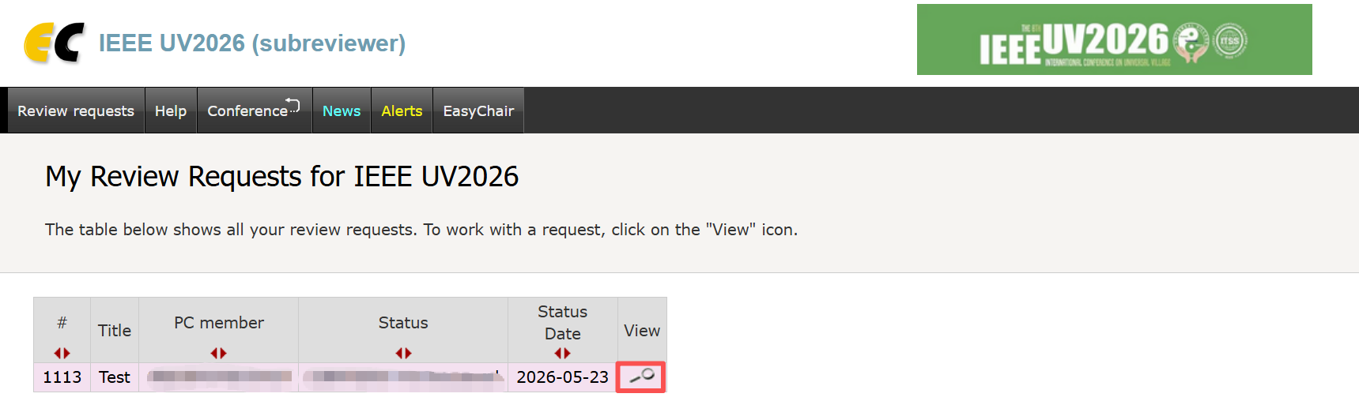
2.1 Method 1: Use Your Own EasyChair Account-3
b) Click the view icon to open the assigned review request.

Slide 15
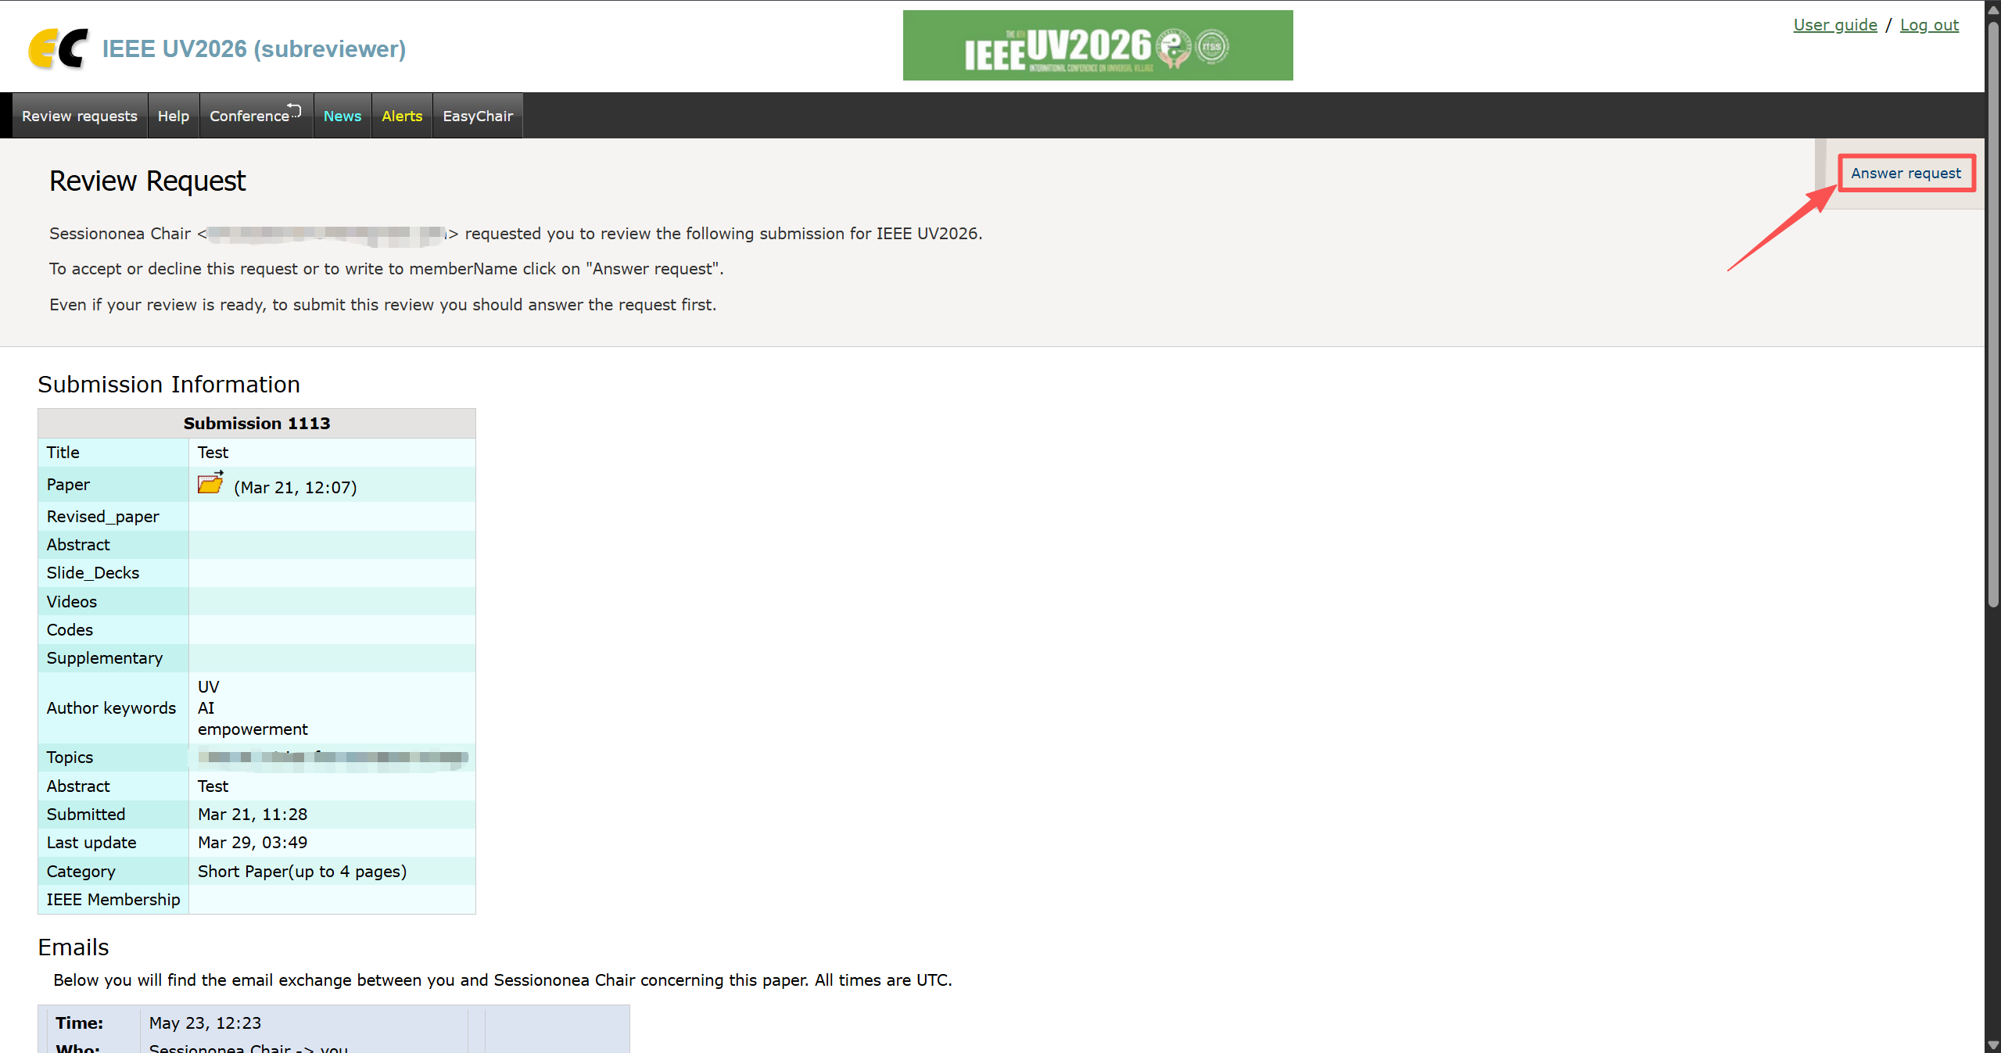
2.1 Method 1: Use Your Own EasyChair Account-4
c) Review the request paper sent by your session chair.
You must respond to the request by clicking “Answer request” to accept the review.

Slide 16
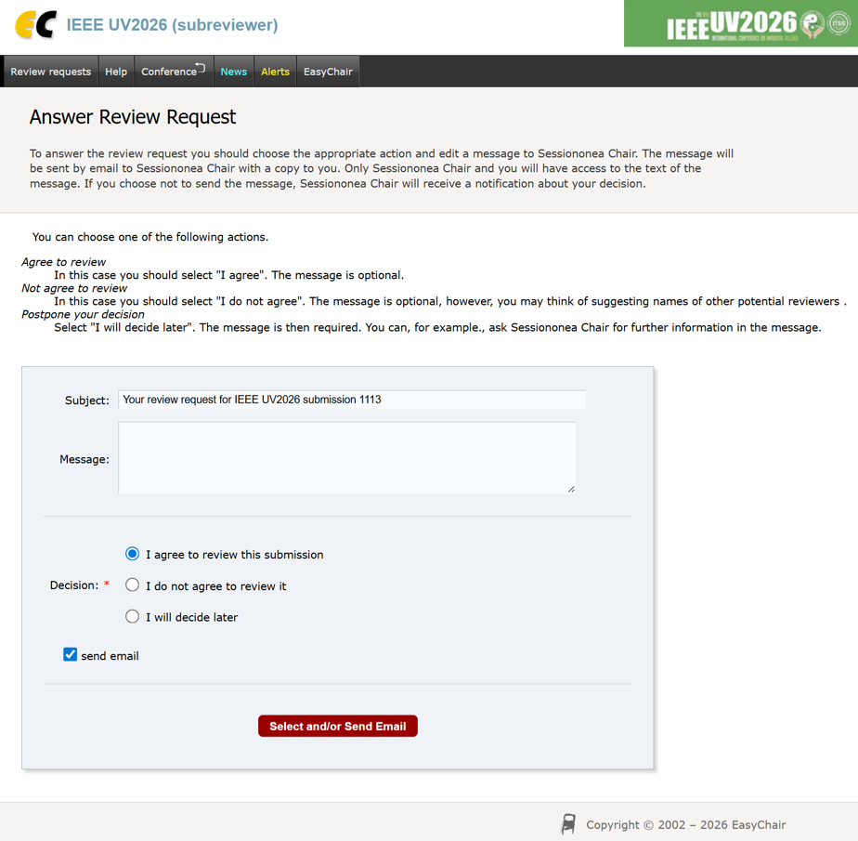
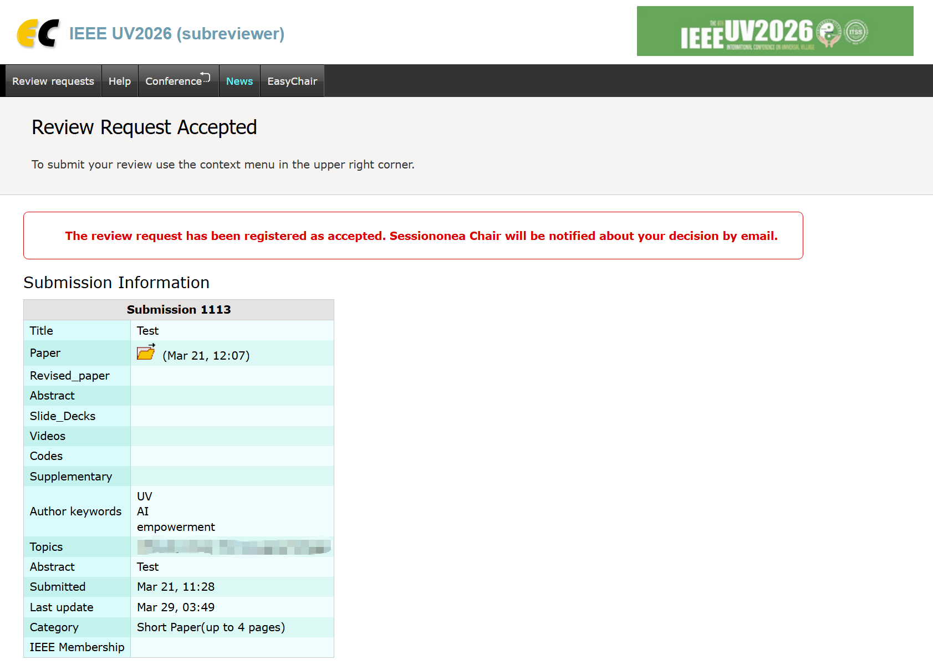
2.1 Method 1: Use Your Own EasyChair Account-5
d) Follow the instructions on the page to accept the review request.

Slide 17

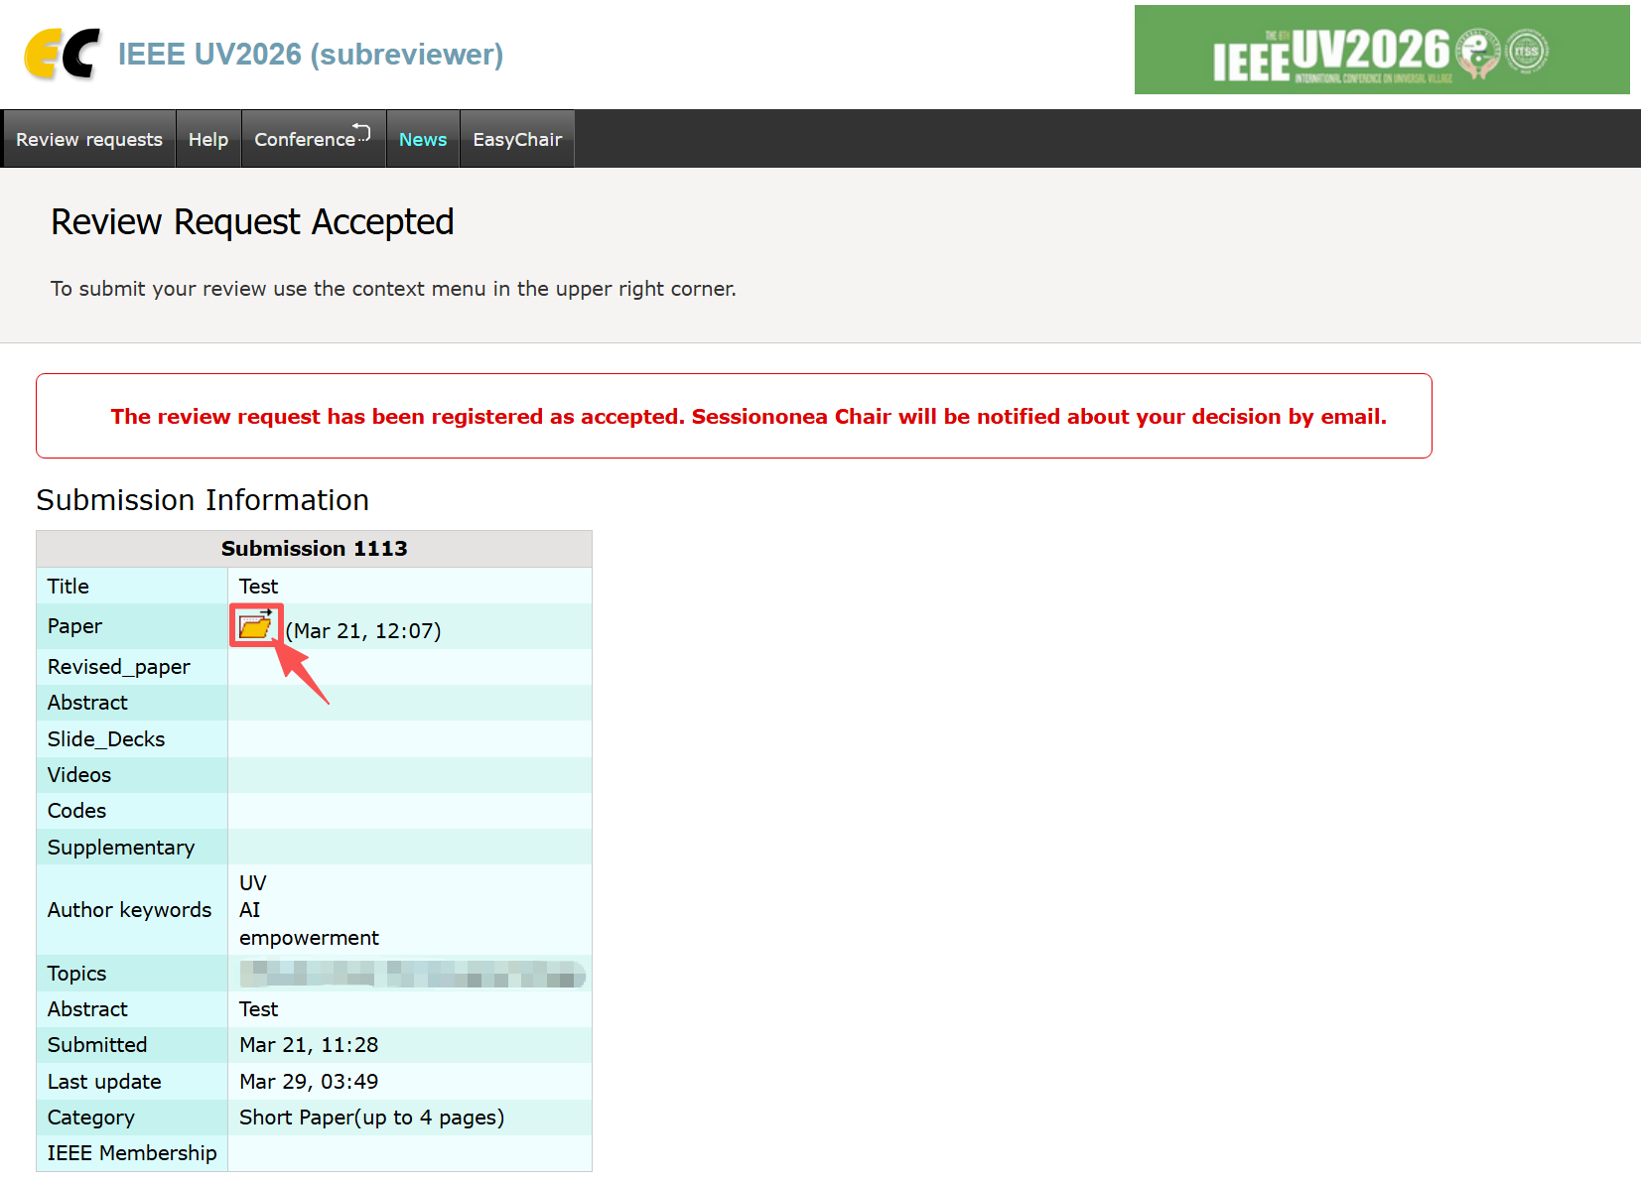
2.1 Method 1: Use Your Own EasyChair Account-6
e) Download the assigned paper by clicking the download icon .

Slide 18
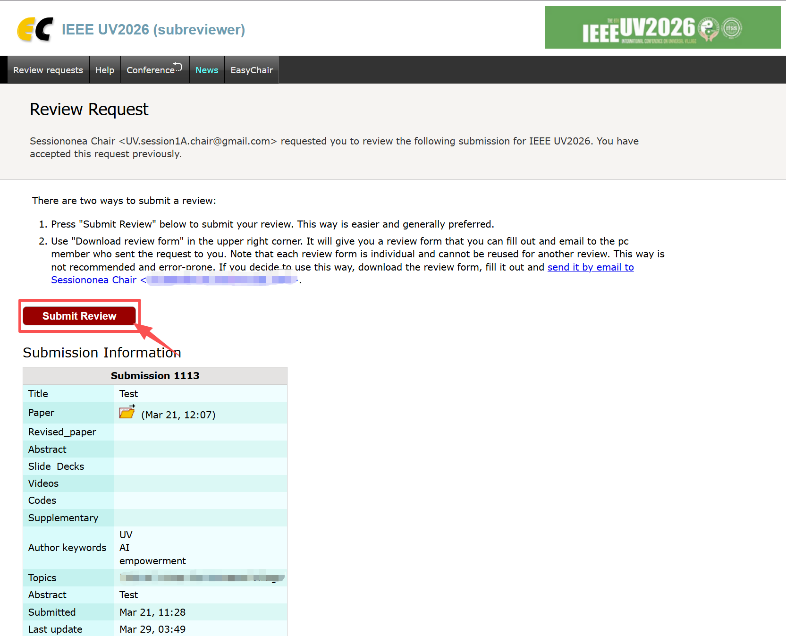
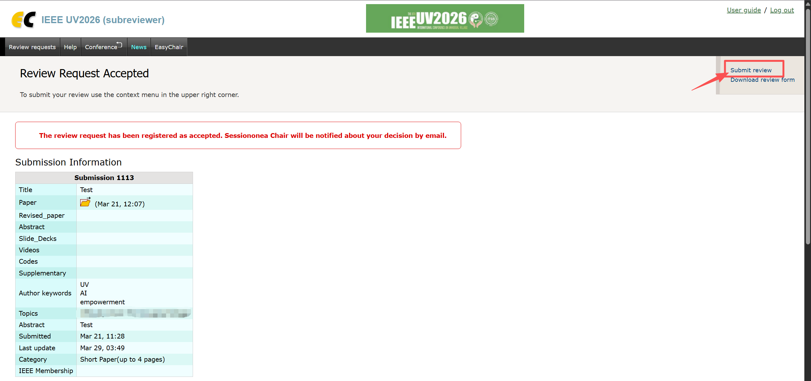
2.1 Method 1: Use Your Own EasyChair Account-7
f) Click “Submit Review” to open the review form.

Slide 19
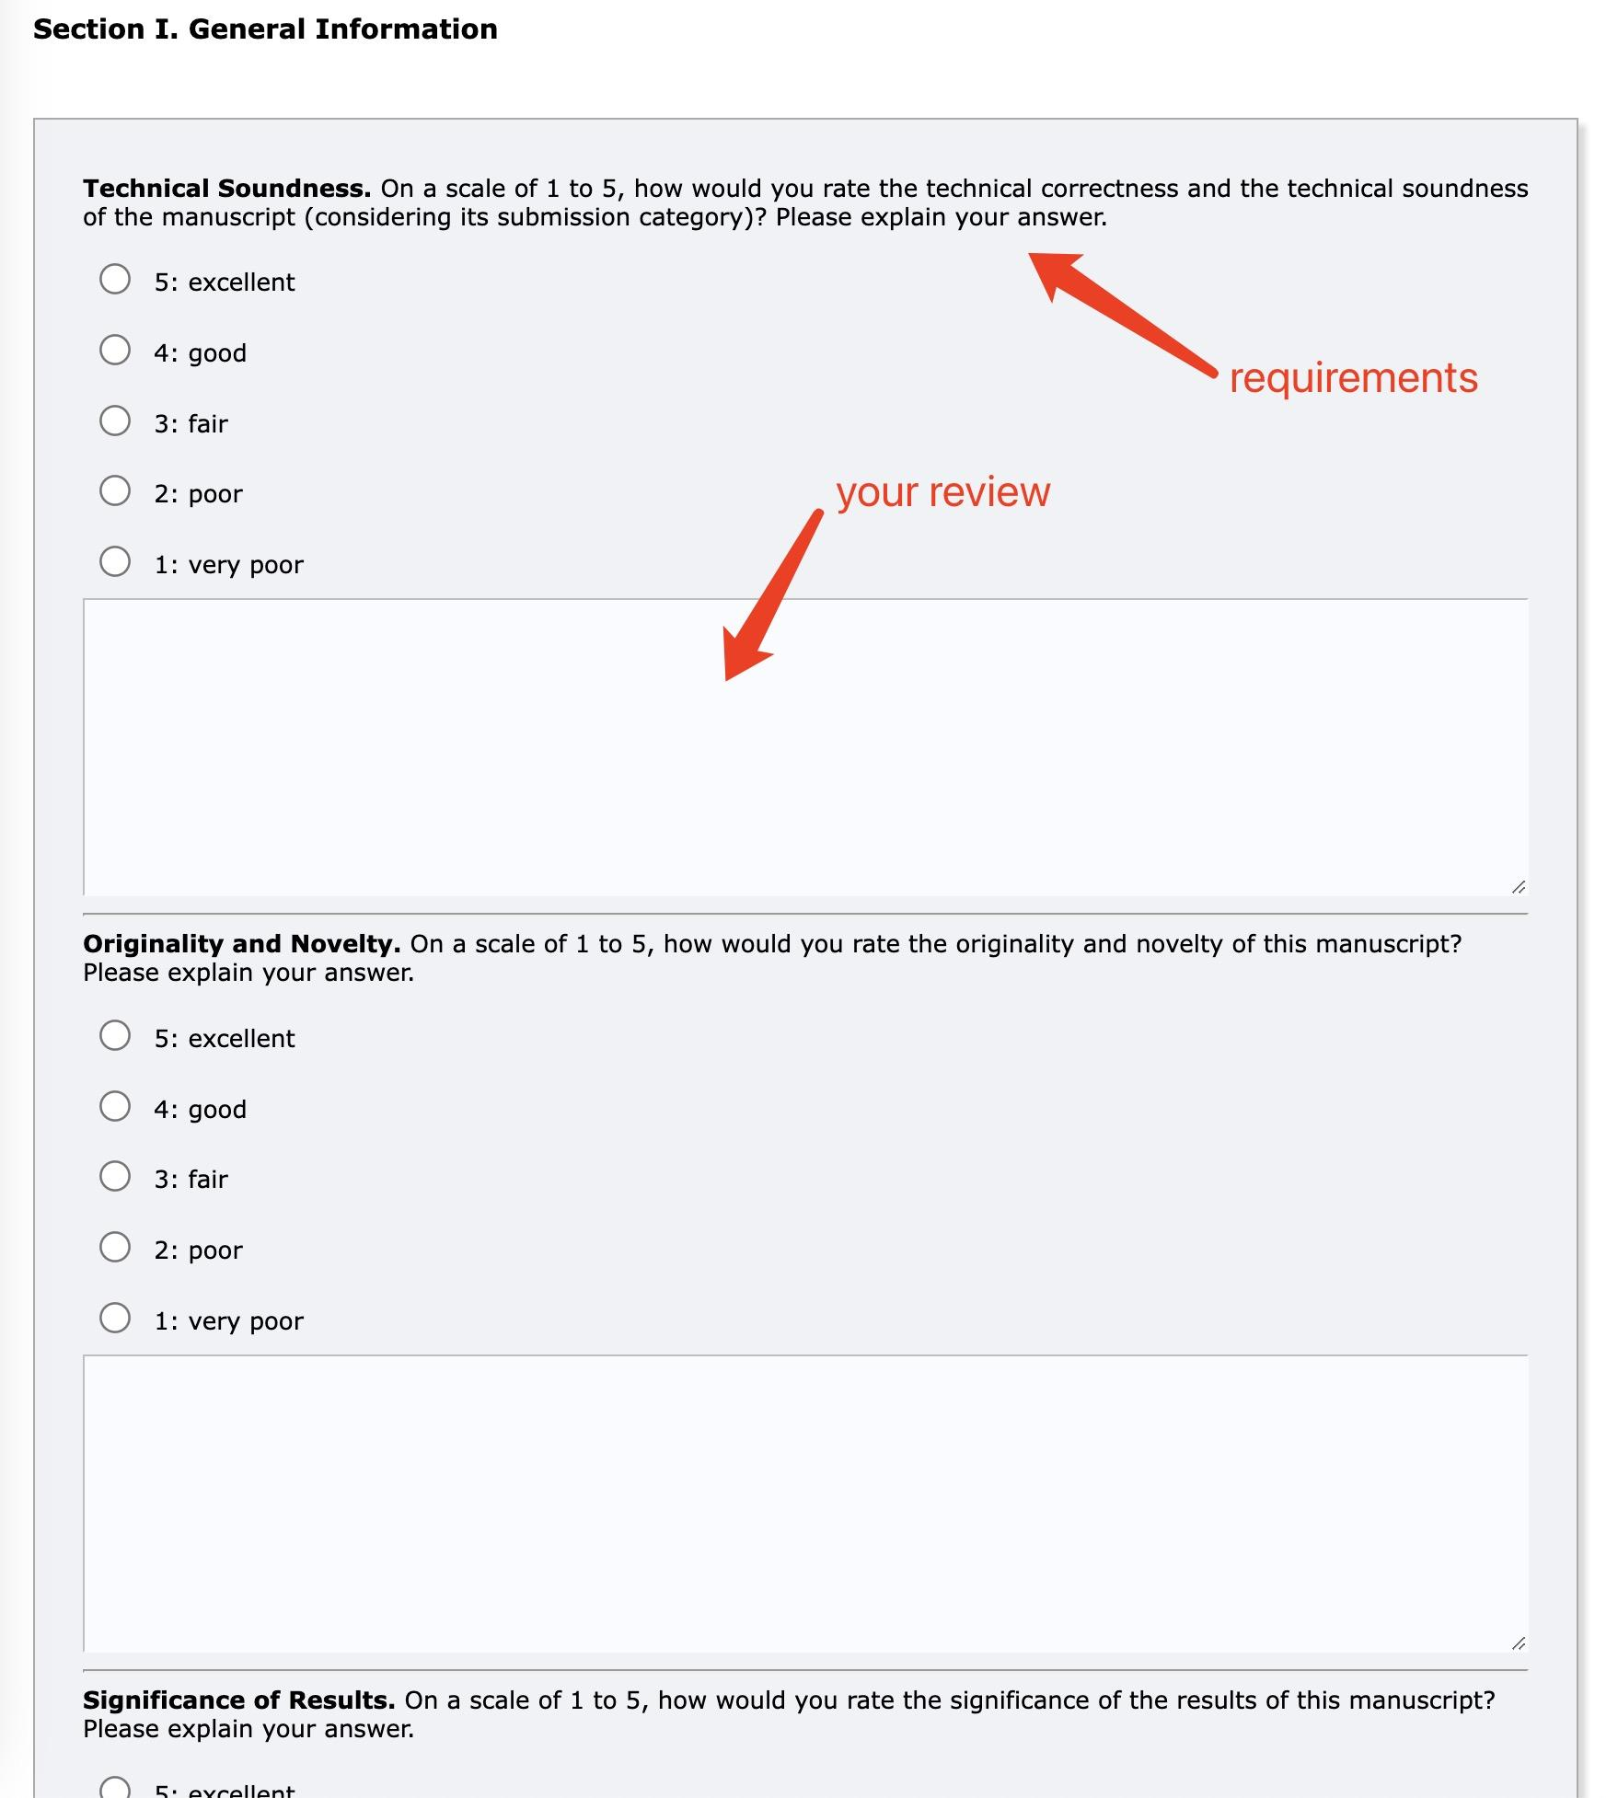
2.1 Method 1: Use Your Own EasyChair Account-8
g) Evaluate the paper and provide your comments.
Please evaluate the paper according to the review criteria shown in EasyChair, such as relevance, originality, technical quality, clarity, significance, and overall recommendation.
Please provide constructive comments that can help the author(s) improve the paper.
After completing the form, click “Submit Review” to submit your review.

Slide 20
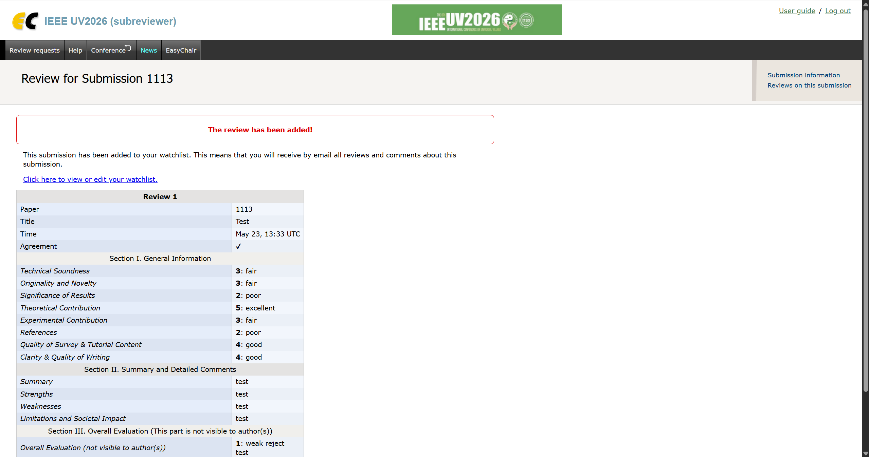
2.1 Method 1: Use Your Own EasyChair Account-9
h) Your review has been successfully submitted.

Slide 21
2.2 Method 2: Offline Review Form
If you are unable to use EasyChair, please contact your session chair or the UV2026 Organizing Committee at uv.conf.committee@universal-village.org. We will send the assigned paper and an offline review form to you by email.
After completing the form, please return the completed review form to your session chair or to uv.conf.committee@universal-village.org.

Slide 22
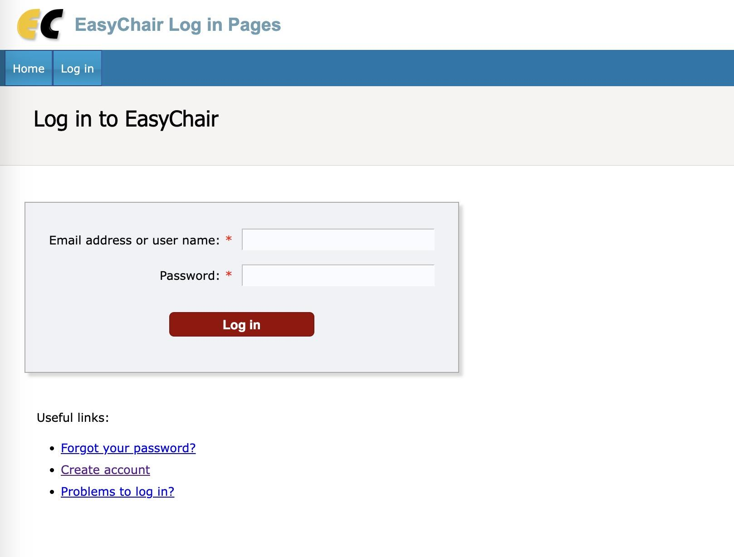
3. Check or Edit a Submitted Review-1
a) Log in to EasyChair using the account you used to submit the review.
*If your review was submitted through the offline review form, please contact your session chair or the UV2026 Organizing Committee if you need to make changes.

Slide 23
3. Check or Edit a Submitted Review-2
b) If you submitted the review through your own EasyChair account, click “Subreviewer” to access your review page.

Slide 24
3. Check or Edit a Submitted Review-3
c) Find the relevant paper and click the view icon to open the submitted review.

Slide 25
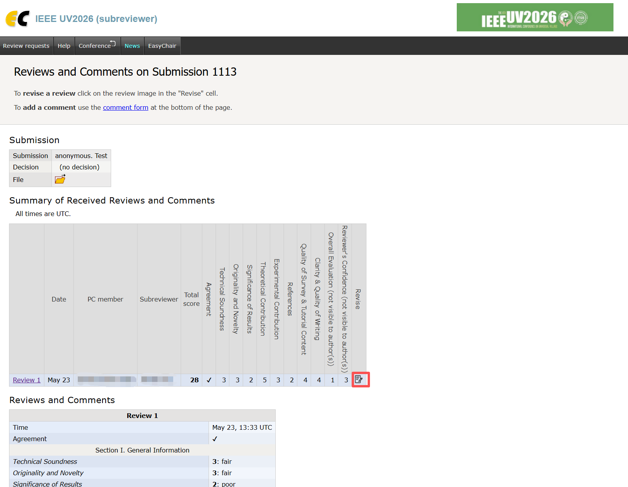
3. Check or Edit a Submitted Review-4
d) Check or Edit a Submitted Review
On this page, you can view the summary of the submitted review. To check the full review details, click the review title, such as “Review 1”.
To revise the review, click the review/edit icon in the “Revise” column, make the necessary updates, and submit the review again to save the changes.

Slide 26
For any question-related inquiries:
uv2026.conf@universal-village.org
Contact Information Account Creation

